Slide 1
The flap technique for pocket therapy

Slide 2
Rationale for periodontal flap surgery
Removal of root surface noxious agents, inflamed tissue and to have an ideal gingival and bone morphology without sacrificing investing and supporting tissues and compromising esthetics.

Slide 3
VARIOUS FLAP TECHNIQUES
POCKET ELIMINATION/
REDUCTION
MODIFIED WIDMAN FLAP
APICALLY POSITIONED FLAP
UNDISPLACED FLAP
CREVICULAR FLAP
PAPILLA PRESERVATION FLAP

Slide 4
DIFFERENCE BETWEEN VARIOUS FLAP TECHNIQUES:
MODIFIED WIDMAN FLAP | UNDISPLACED FLAP | APICALLY DISPLACED FLAP
Purpose:
To expose root surfaces for instrumentation | Accessibility for instrumentation | Improves accessibility
For removal of pocket lining | To remove the pocket wall to reduce/eliminate the pocket | Eliminates pocket by transforming unattached keratinized pocket wall into attached tissue
Variation in design:
Internal bevel incision:
starts close to gingival margin(no more than 1-2mm apical) | At or Just coronal to the base of the pocket | As close to the margin(0.5-1mm) as possible to save keratinized tissue

Slide 5
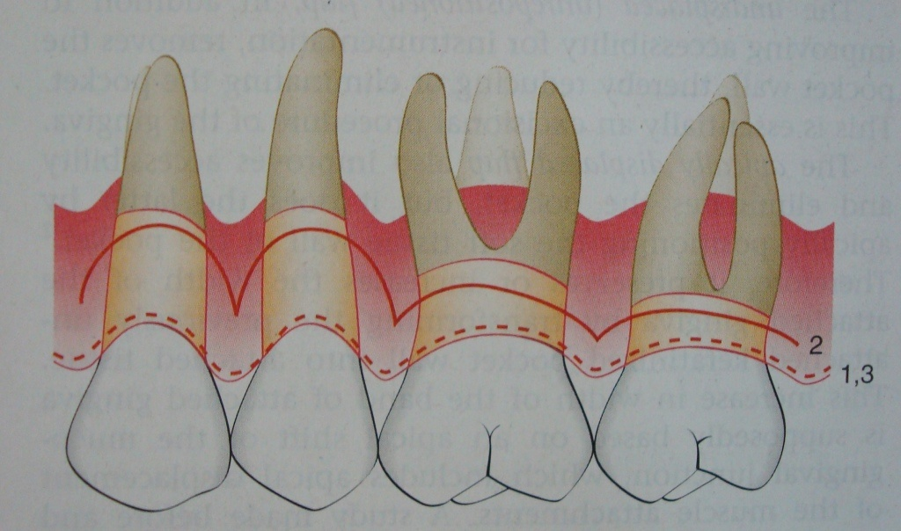
LOCATION OF INTERNAL BEVEL INCISIONS FOR DIFFERENT TYPES OF FLAPS:
mwf & apf- close to gingival margin(1,3)
undisplaced flap- apical to the bottom of the pocket(2)
Scalloping required for the different type of flaps

Slide 6
Modified widman flap surgery

Slide 7
INDICATIONS
In treatment of all types of periodontitis, especially effective with probing depth of 5-7mm
Need for exposing the root for meticulous instrumentation & removal of pocket lining
Pockets where the bases are located coronal to the mucogingival junction.
May be combined with larger and fully reflected flaps and special procedures such as wedge excisions, root resection, hemisection etc

Slide 8
CONTRAINDICATIONS
Gingival enlargement
Little or no attached gingiva
Presence of bone thickening or exostosis

Slide 11
Internal bevel incision
Removes the pocket lining.
Conserves relatively uninvolved surface of the outer gingiva.
Produces a sharp, thin flap margin for adaptation to bone-tooth junction.

Slide 12
INTERNAL BEVEL INCISION

Slide 13
Internal bevel incision – the position
It is advocated in cases of moderate pockets with good amount of attached gingiva, thick gingival biotype and rounded gingival contour.

Slide 14
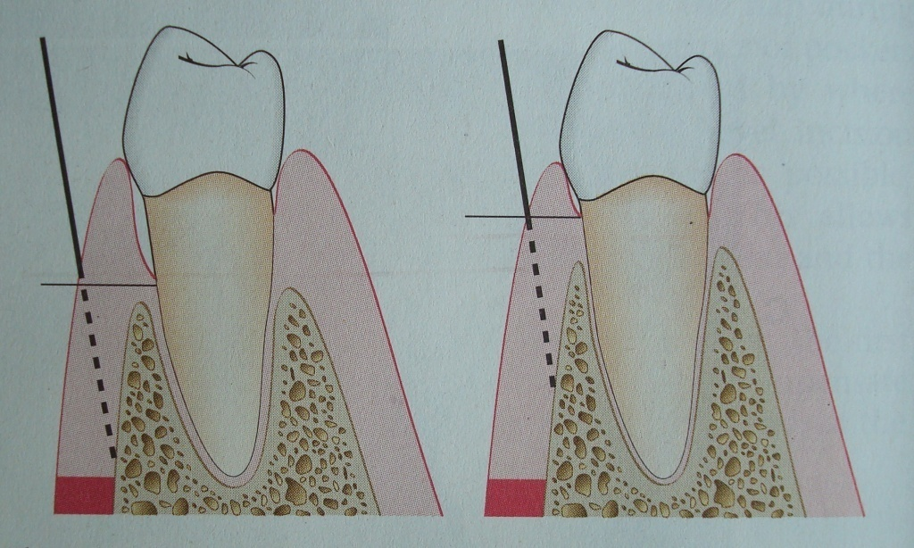
UNDISPLACED FLAP
“ INTERNAL BEVEL GINGIVECTOMY”
INDICATION- Adequate amount of attached gingiva even after elimination of the pocket wall
LOCATION OF TWO DIFFERENT AREAS WHERE INTERNAL BEVEL IS MADE IN UNDISPLACED FLAP

Slide 15
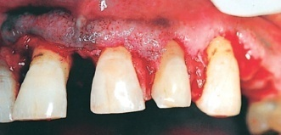
TECHNIQUE:
STEP 1: Mark base of pocket
STEP 2: Internal bevel incision: to a point apical to alveolar crest
STEP 3: Second/crevicular incision
STEP 4:Flap Reflection
A.INCISION
STEP5:Third/interdental incision
separating connective tissue from bone
B.REFLECTION

Slide 16
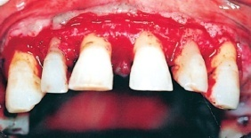
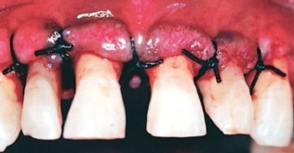
STEP6:Removal of triangular wedge.
STEP7:Debridement.
STEP8:Flap edge should rest on root bone junction. Trim flap if required
STEP9:Suturing
C.DEBRIDEMENT
D.SUTURES

Slide 17
APICALLY POSITIONED FLAP

Slide 18
INDICATIONS:
Pockets extending beyond mucogingival line
Narrow zone of keratinized gingiva
Crown lengthening procedure for restorative and prosthodontic purposes

Slide 19
CONTRAINDICATIONS:
1. Periodontal pockets in severe periodontal disease
2. Periodontal pockets in areas where esthetics is critical
3. Deep intrabony defects
4. Patient at high risk for caries
5. Severe hypersensitivity
6. Tooth with marked mobility and severe attachment loss
7. Tooth with extremely unfavourable clinical crown/root ratio

Slide 20
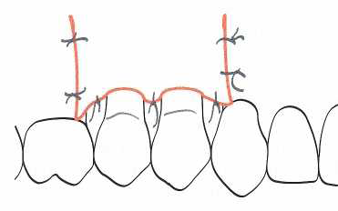
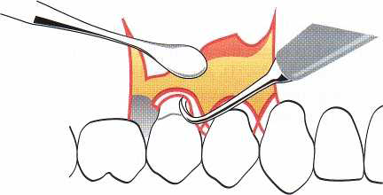

Slide 21
Papilla preservation technique – when and why??
When there is wide interproximal space
Esthetic considerations
Coverage of bone grafts
Mostly limited to anterior teeth
Due to incomplete removal of granulation tissue & dead space, often results in pocket recurrence

Slide 22
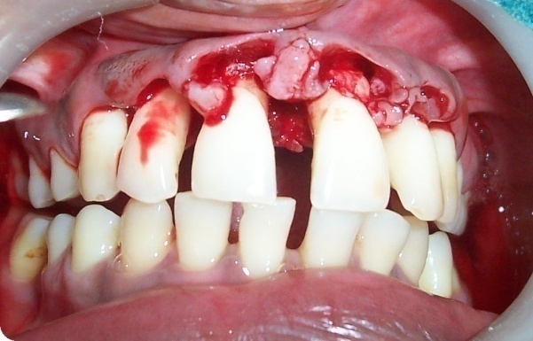
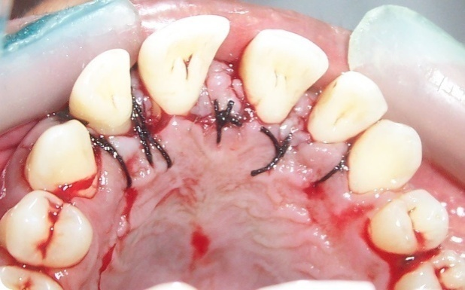

Slide 23
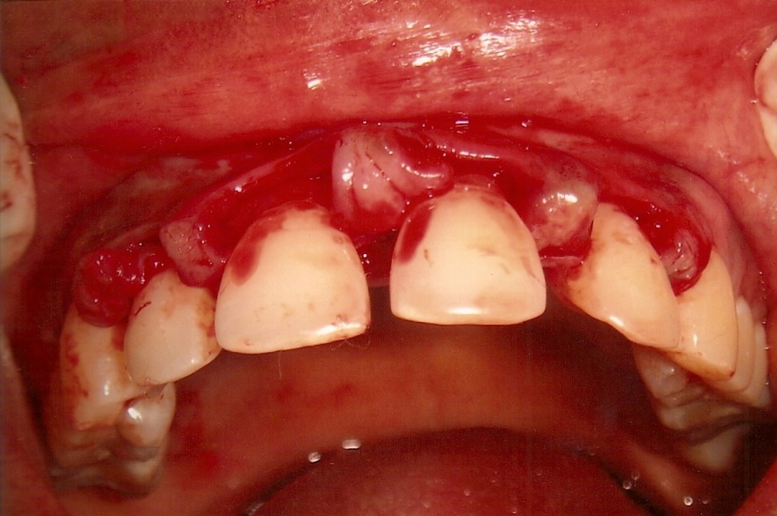
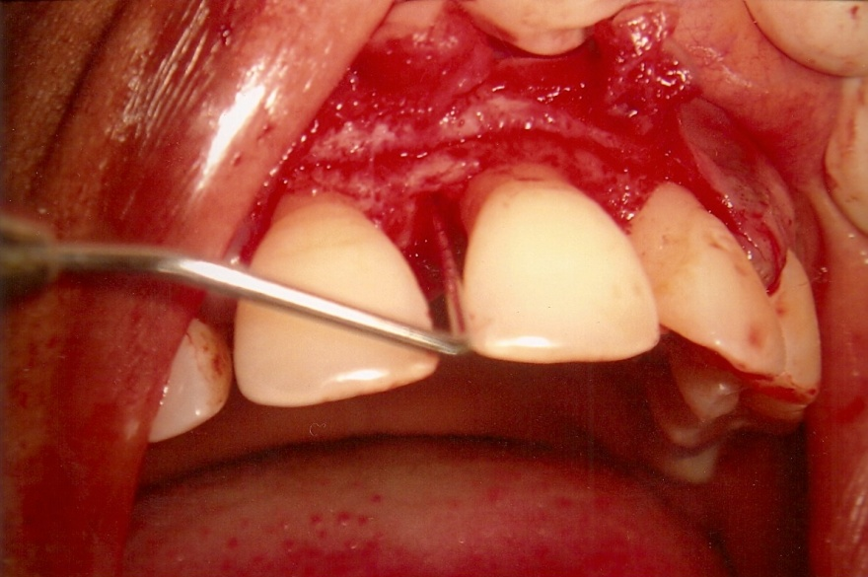
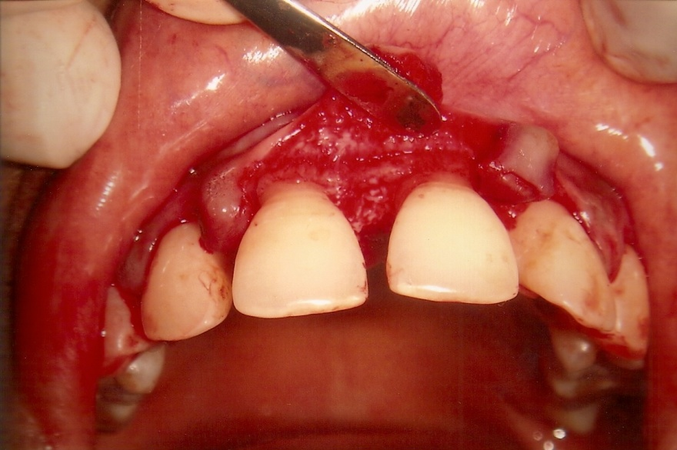
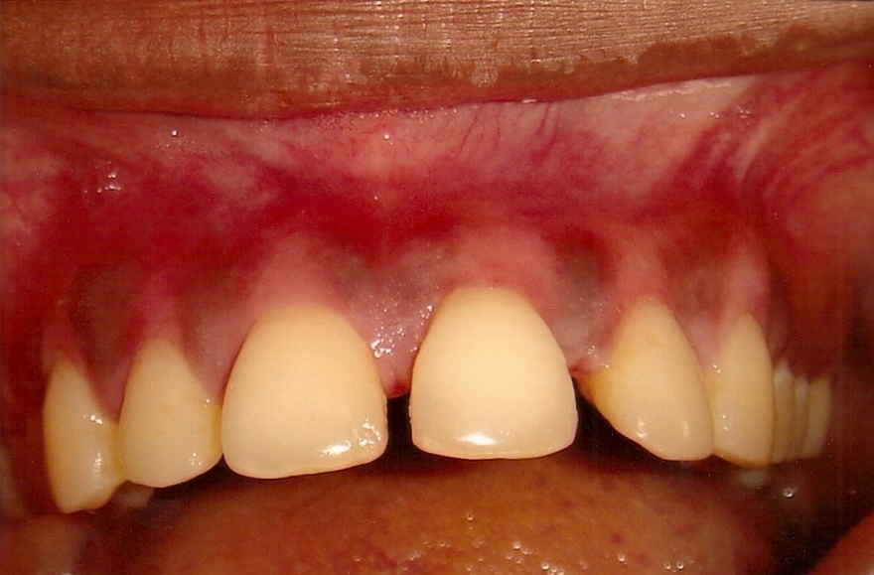

Slide 24
DISTAL MOLAR SURGERY
INDICATIONS:-
1. Presence of bulbous tissues over the tuberosity
2. A prominent retromolar pad in the mandible
3 .Inadequate attached gingiva
4. Abruptly ascending tuberosity
5. A close ascending ramus of the mandible

Slide 25
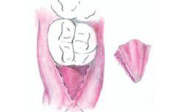
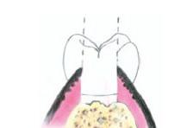
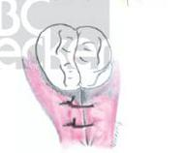
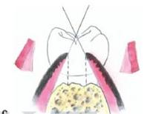
TRIANGULAR DESIGN
For mandibular molar
a.Outline of incision distal to molar
b.Cross sectional view showing wedge removal
d.Trimming of flap and suturing
c.Undermining incisions for thinning of tissue

Slide 26
FOR MAXILLARY MOLARS- SQUARE, PARALLEL OR H DESIGN (modified distal wedge procedure).
INDICATION:
Deep periodontal pocket combined with an angular
bone defect at the distal aspect of a maxillary molar
ADVANTAGES:
Allows conservation of keratinized tissue and maximum closure
Provides greater access to underlying bony topography and distal furcation

Slide 27
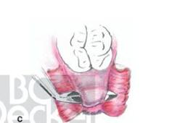
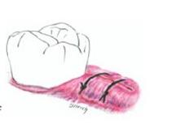
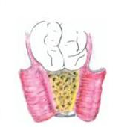
b.
Two parallel reverse bevel incisions joined with buccolingual incision
Flap reflection and tissue removal
d.
c
suturing
Correction of osseous irregularities

Slide 28
COMPLICATIONS

Slide 29
INTRA-OPERATIVE COMPLICATIONS
INTRA-OPERATIVE
Hemorrhage
Soft tissue injury
Allergy
&
Anaphylaxis
Pain, Anxiety & Syncope

Slide 30
POST-OPERATIVE COMPLICATIONS
POST-OPERATIVE
Hemorrhage
Swelling
Infections
(Intra & Post surgical)
Pain

Slide 31
THANK YOU

